Slide 1



ASP.NET Essentials
ASP.NET MVC
Introduction
SoftUni Team
Technical Trainers
Software University
http://softuni.bg

Slide 2
Have a Question?
sli.do #CSharpWeb

Slide 3
Table of Contents
Mapping Routes in RoutesConfig
Route Constraints
Razor introduction

Slide 4

ASP.NET MVC Routing

Slide 5
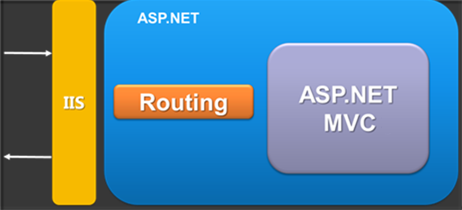
ASP.NET MVC Routing
Mapping between patterns and a combination of
controller + action + parameters
Routes are defined as a global list of routes
System.Web.Routing.RouteTable.Routes
Greedy algorithm
The first match (from top to bottom) wins

Slide 6
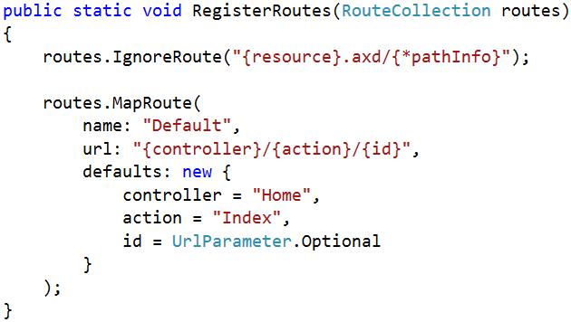
Mapping Routes in RoutesConfig
In Global.asax in the Application_Start() there is:
RouteConfig.RegisterRoutes(RouteTable.Routes);
RoutesConfig class is located in /App_Start/ in internet applications template by default
Routes to ignore
The [*] means everything else
Route name
Route pattern
Default parameters

Slide 7
Routing Examples
Controller: Products
Action: ById
Id: 3
http://localhost/Products/ById/3

Slide 8
Routing Examples (2)
Controller: Products
Action: ById
Id: 0 (optional parameter)
http://localhost/Products/ById

Slide 9
Routing Examples (3)
Controller: Products
Action: Index
Id: 0 (optional parameter)
http://localhost/Products

Slide 10
Routing Examples (4)
Controller: Home
Action: Index
Id: 0 (optional parameter)
http://localhost/

Slide 11
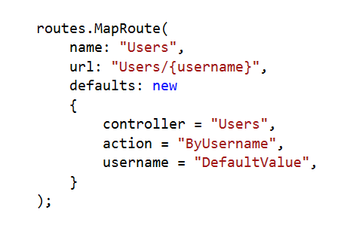
Custom Route
Controller: Users
Action: ByUsername
Username: Nakov
http://localhost/Users/Nakov

Slide 12
Custom Route (2)
Controller: Users
Action: ByUsername
Username: DefaultValue
http://localhost/Users

Slide 13
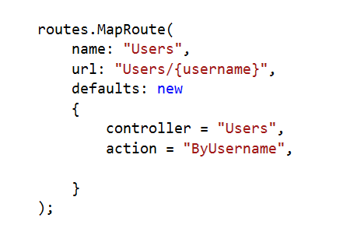
Custom Route (3)
Result: 404 Not Found
?
http://localhost/Users

Slide 14
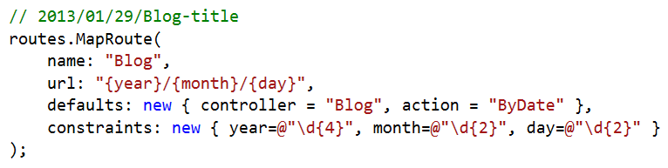
Route Constraints
Constraints are rules on the URL segments
All the constraints are regular expression compatible with class Regex
Defined as one of the routes.MapRoute(…) parameters

Slide 15
Debugging Routes
In actions we have access to a data structure called RouteData
RouteData.Values["controller"]
RouteData.Values["action"]
RouteData.Values["id"]

Slide 16
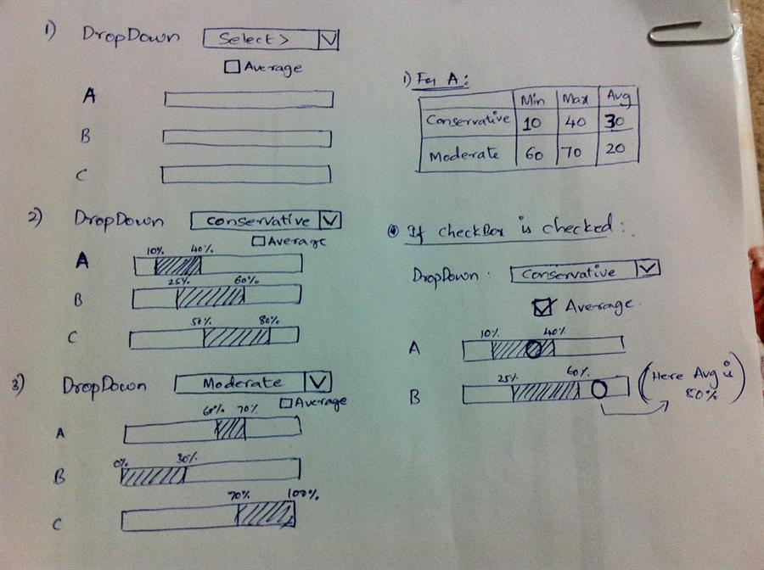
Razor Views

Slide 17
Views
HTML templates of the application
A lot of view engines available
View engines execute code and provide HTML
Provide a lot of helpers to easily generate HTML
The most popular is Razor
We can pass data to views through:
ViewBag, ViewData and Model (strongly-typed views)

Slide 18
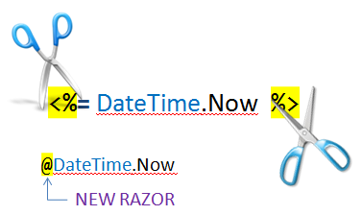
Razor
Template markup syntax
Simple-syntax view engine
Based on the C# programming language
Enables the programmer to use an HTML construction workflow
Code-focused templating approach, with minimal transition between HTML and code
Razor syntax starts code blocks with a @ character and does not require explicit closing of the code-block

Slide 19
Passing Data to a View
With ViewBag (dynamic type):
Action: ViewBag.Message = "Hello World!";
View: @ViewBag.Message
With ViewData (dictionary)
Action: ViewData["message"] = "Hello World!";
View: @ViewData["message"]
With Strongly-typed views:
Action: return View(model);
View: @model ModelDataType;

Slide 20
Razor Syntax
@ – For values (HTML encoded)
@{ … } – For code blocks (keep the view simple!)
<p>
Current time is: @DateTime.Now!!!
Not HTML encoded value: @Html.Raw(someVar)
</p>
@{
var productName = "Energy drink";
if (Model != null)
{
productName = Model.ProductName;
}
else if (ViewBag.ProductName != null)
{
productName = ViewBag.ProductName;
}
}
<p>Product "@productName" has been added in your shopping cart</p>

Slide 21
Razor Syntax (2)
If, else, for, foreach, etc. C# statements
HTML markup lines can be included at any part
@: – For plain text line to be rendered
<div class="products-list">
@if (Model.Products.Count() == 0)
{
<p>Sorry, no products found!</p>
}
else
{
@:List of the products found:
foreach(var product in Model.Products)
{
<b>@product.Name, </b>
}
}
</div>

Slide 22
Razor Syntax (3)
Comments
What about "@" and emails?
@*
A Razor Comment
*@
@{
//A C# comment
/* A Multi
line C# comment
*/
}
<p>
This is the sign that separates email names from domains: @@<br />
And this is how smart Razor is: spam_me@gmail.com
</p>

Slide 23
Razor Syntax (4)
@(…) – Explicit code expression
@using – for including namespace into view
@model – for defining the model for the view
<p>
Current rating(0-10): @Model.Rating / 10.0 @* 6 / 10.0 *@
Current rating(0-1): @(Model.Rating / 10.0) @* 0.6 *@
spam_me@Model.Rating @* spam_me@Model.Rating *@
spam_me@(Model.Rating) @* spam_me6 *@
</p>
@using MyFirstMvcApplication.Models;
@model UserModel
<p>@Model.Username</p>

Slide 24








ASP.NET Essentials
https://softuni.bg/courses/

Slide 25
License
This course (slides, examples, demos, videos, homework, etc.) is licensed under the "Creative Commons Attribution-NonCommercial-ShareAlike 4.0 International" license

Slide 26






Free Trainings @ Software University
Software University Foundation – softuni.org
Software University – High-Quality Education, Profession and Job for Software Developers
softuni.bg
Software University @ Facebook
facebook.com/SoftwareUniversity
Software University @ YouTube
youtube.com/SoftwareUniversity
Software University Forums – forum.softuni.bg

